Slide 1
Java DataBase Connectivity ( JDBC )

Slide 2
Objective
At the end of the session, participants will be able to:
Understand JDBC Architecture
Differentiate among JDBC Driver types
Perform CRUD operations using JDBC

Slide 3
Agenda
JDBC Architecture
Types of JDBC Drivers
Loading JDBC Driver
Connecting to Database
Manipulate data in the Database
CONFIDENTIAL© Copyright 2008 Tech Mahindra Limited

Slide 4
What is JDBC?
An API specification developed by Sun Microsystems
Defines a uniform interface for accessing various relational databases
The JDBC API uses a Driver Manager and database-specific drivers to provide connectivity to heterogeneous databases
Driver Manager can support multiple concurrent drivers connected to multiple heterogeneous databases
A JDBC driver translates standard JDBC calls into a network or database protocol or into a database library API call that facilitates communication with the database

Slide 5
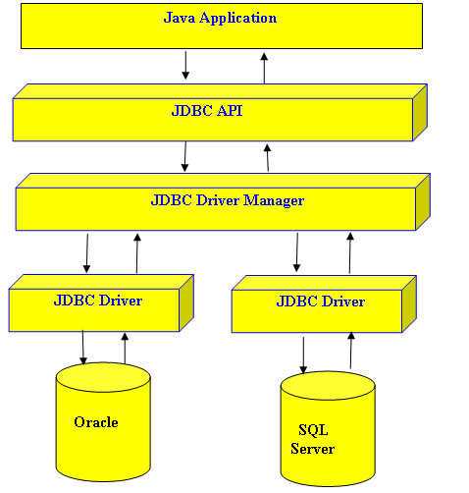

JDBC Architecture
Notes:
1) Java Developers found that they require a frame work that will allow
them to build a uniform interface over the database connectivity systems.
Such a framework would allow programmer to write a single database
interface over many Platforms.
2)This frame work is known as the java database connectivity interface.
3) JDBC is closely modeled on the SQL call level interface.
4) JDBC layer comprises of two main layers:-
a) JDBC API
b) JDBC Driver API
5)The JDBC API is the layer with which the java program interfaces
It basically defines set of classes for use in java applet /applications which are
independent of the underlying database.
6) The JDBC Driver API on the other hand ,provides link between the database and JDBC API.
7) The JDBC Driver API layer is provided by the database Vendor.
8) JDBC API is made up of 4 main interfaces:-
a) java.sql.DriverManager
b) java.sql.Connection
c) java.sql.Statement
d) java.sql.ResultSet
In addition to these, the following support interfaces are also available
java.sql.CallableStatement
java.sql.PreparedStatement
java.sql.ResultSetMetadata
java.sql.DatabaseMetaData

Slide 6
Types of JDBC Drivers
Four distinct types of JDBC drivers:
JDBC-ODBC Bridge Driver - Type1
Native API Java Driver - Type2
Java to Network Protocol Driver - Type3
Pure Java Driver - Type4

Slide 7
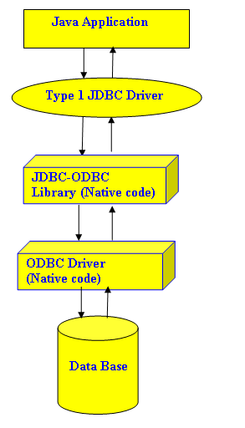
Type 1: JDBC-ODBC Bridge Driver
Notes:
Functions:
Translates query obtained by JDBC into corresponding ODBC query, which is then handled
by the ODBC driver.
Sun provides a JDBC-ODBC Bridge driver. sun.jdbc.odbc.JdbcOdbcDriver.
Client -> JDBC Driver -> ODBC Driver -> Database
There is some overhead associated with the translation work to go from JDBC to ODBC.
Advantages:
Almost any database for which ODBC driver is installed, can be accessed.
Disadvantages:
Performance overhead since the calls have to go through the JDBC overhead bridge to the
ODBC driver, then to the native database connectivity interface.
The ODBC driver needs to be installed on the machine.

Slide 8
Type 1: JDBC-ODBC Bridge Driver (Contd…)
Act as a "bridge" between JDBC & database connectivity mechanism like ODBC
The bridge provides JDBC access using most standard ODBC drivers
This driver is included in the Java 2 SDK within the sun.jdbc.odbc package
JDBC statements call the ODBC by using the JDBC - ODBC Bridge and finally the query is executed by the database

Slide 9
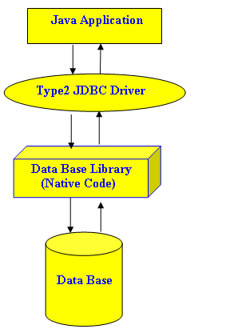
Type 2: Java to Native API Driver
Notes:
Functions:
This type of driver converts JDBC calls into calls to the client API for that database.
Client -> JDBC Driver -> Vendor Client DB Library -> Database
Advantage
Better performance than Type 1 since no jdbc to odbc translation is needed.
Disadvantages
The vendor client library needs to be installed on the client machine.
Cannot be used in internet due the client side software needed.

Slide 10
Type 2: Java to Native API Driver (Contd…)
Use the Java Native Interface (JNI) to make calls to a local database library API
Converts JDBC calls into a database specific call for databases such as SQL, ORACLE etc.
Communicates directly with the database server & requires some native code to connect to the database
Usually faster than Type 1 drivers
Like Type 1 drivers, Type 2 drivers require native database client libraries to be installed and configured on the client machine

Slide 11
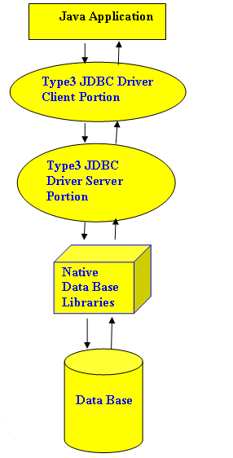
Type 3: Java to Network Protocol Driver
Notes:
Functions:
Follows a three tier communication approach.
Can interface to multiple databases - Not vendor specific.
The JDBC Client driver written in java, communicates with a middleware-net-server using a database
independent protocol, and then this net server translates this request into database commands for that
database.
Thus the client driver to middleware communication is database independent.
Client -> JDBC Driver -> Middleware-Net Server -> Any Database
Advantages
The communication between client and the middleware server is database independent, there is no need
for the vendor database library on the client machine. Also the client to middleware need'nt be changed for a
new database.
It Can be used in internet since there is no client side software needed.
At client side a single driver can handle any database.(It works provided the middlware supports that
database!!)
Disadvantages
Requires database-specific coding to be done in the middle tier.
An extra layer added may result in a time-bottleneck. But typically this is overcome by providing efficient
Middleware services.

Slide 12
Type 3: Java to Network Protocol Driver (Contd…)
Pure Java drivers that use a proprietary network protocol to communicate with JDBC middleware on the server
The middleware then translates the network protocol to database-specific function calls
Do not require native database libraries on the client and can connect to many different databases on the back end
Can be deployed over the Internet without client installation

Slide 13
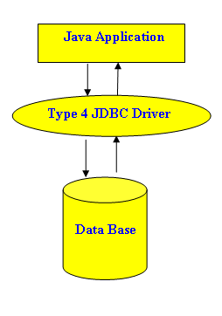
Type 4: Java to Database Protocol Driver
Notes:
Functions
Type 4 drivers are entirely written in Java that communicate directly with a vendor's
database through socket connections. No translation or middleware layers, are required,
therefore improving performance.
The driver converts JDBC calls into the vendor-specific database protocol so that client
applications can communicate directly with the database server.
Completely implemented in Java to achieve platform independence.
e.g include the widely used Oracle thin driver - oracle.jdbc.driver.
Client Machine -> Native protocol JDBC Driver -> Database server
Advantages
These drivers don't translate the requests into db request to ODBC or pass it to client API
for the db, nor do they need a middleware layer for request indirection. Thus the
performance is considerably improved.
Disadvantage
At client side, a separate driver is needed for each database.

Slide 14
Type 4: Java to Database Protocol Driver (Contd…)
Pure Java drivers that implement a proprietary database protocol to communicate directly with the database
Like Type 3 drivers, they do not require native database libraries and can be deployed over the Internet without client installation
One drawback is that they are database specific
Communicate directly with the database engine rather than through middleware or a native library
Usually the fastest JDBC drivers available
Directly converts java statements to SQL statements

Slide 15
Loading the Driver
Can be done in two ways:
  Using DriverManager: Uses system property jdbc.drivers to
  know drivers to be loaded
  Using Class.forName():
    A fully qualified name of the driver class should be passed as a parameter
    The following call will load the Sun JDBC-ODBC driver:
Class.forName (“sun.jdbc.odbc.JdbcOdbcDriver”)

Slide 16
Connecting to Database
The getConnection() method:
  A static method of DriverManager class
  Provides many overloaded versions
  Returns a Connection object
URL
//-----------Connection with Type-1 Driver------------------//
con=DriverManager.getConnection("jdbc:odbc:tech","scott","tiger");
Port
//-----------Connection with Type-4 Driver------------------//
con=DriverManager.getConnectionjdbc:oracle:thin:@10.10.3.159:1521:itpdb“,"scott","tiger");
Driver Type
Server IP
Service ID

Slide 17
The Connection Interface
When a Connection is opened, this represents a single instance of a particular database session
As long as the connection remains open, SQL queries may be executed and results obtained
Has Methods which return objects of:
  Statement
  PreparedStatement
  CallableStatement

Slide 18
The Statement Interface
Used pass a SQL String to the database for execution and to retrieve result from database
The createStatement() method of Connection interface returns a Statement object
Provides methods to execute SQL statements:
  executeQuery()
    Used for SQL statements such as simple SELECT, which return a single result set
  executeUpdate()
    Used for other SQL statements like INSERT, UPDATE & DELETE
Connection object will give statement object
stmt=con.createStatement();

Slide 19
The PreparedStatement Interface
The prepareStatement() method of Connection interface returns a PreparedStatement object
Useful for frequently executed SQL statements
An SQL statement is pre-compiled and gets executed more efficiently than a plain statement
For example: the statement “INSERT INTO EMP VALUES (?, ?)” can be used to add multiple records, with a different values each time
  ‘?’ acts as a placeholder
Records are in emp table as follows:
pspmt=con.prepareStatement("insert into emp values(?,?)");
pspmt.setInt(1,26788);
pspmt.setString(2,"Ajay");

Slide 20
The PreparedStatement Interface (Contd…)
The PreparedStatement Interface:
  methods executeQuery() and executeUpdate for statement execution
  setXXX() methods for assigning values for the placeholders
    XXX stands for the data type of the value of the placeholder
    For example: setString(), setInt(), setFloat(), setDouble() etc.
To delete a record, the following code snippet is used:
pstmt = con.prepareStatement("Delete FROM emp WHERE empno=?”)
pstmt.setString(1,eno);
int i = pstmt.executeUpdate();

Slide 21
The PreparedStatement Interface (Contd…)
To update records, the following code snippet can be used:
PreparedStatement stmt = con.prepareStatement("update Emp SET Ename = ? WHERE Empno = ?");
st.setString(1,"Amit");
st.setString(2,“50000");
int i = stmt.executeUpdate();

Slide 22
The CallableStatement Interface
A CallableStatement object is created by calling the prepareCall() method on a Connection object
The object provides a way to call stored procedures in a standard way for all DBMS
CallableStatement inherits Statement methods, which deal with SQL statements in general, and it also inherits PreparedStatement methods, which deal with IN parameters
All methods defined in the CallableStatement deal with OUT parameters or the output aspect of INOUT parameters

Slide 23
The CallableStatement Interface (Contd…)
Syntax for a stored procedure without parameters is:
{call procedure_name}
Syntax for procedure call with two parameters:
{call procedure_name[(?, ?)] }

Slide 24
The CallableStatement Interface (Contd…)
\\ Creating CallableStatement
CallableStatement cs;
cs=con.prepareCall("{call SHOW_SUPPLIERS}");
ResultSet rs = cs.executeQuery();
\\ Stored Procedures with parameters
int age = 39;
String poetName = "dylan thomas";
CallableStatement proc =
con.prepareCall("{call set_age(?, ?)}");
proc.setString(1, poetName);
proc.setInt(2, age);
cs.execute();

Slide 25
The ResultSet Interface
The result of an SQL statement execution can be:
  A ResultSet object
    The object returned by executeQuery() method
    Contains records retrieved by the SELECT statement
  An integer
    Returned in case of INSERT, UPDATE, DELETE statements
    Indicates the number of rows affected due to the statement
rs = stmt.executeQuery("select * from emp");

Slide 26
The ResultSet Interface (Contd…)
A ResultSet object represents the output table of data resulted from a SELECT query statement with following features:
The data in a ResultSet object is organized in rows & columns
Each ResultSet object maintains a cursor (pointer) to identify the current data row
The cursor of a newly created ResultSet object is positioned before the first row
Notes:
ResultSet objects support 3 types of scrollabilities: TYPE_FORWARD_ONLY (default), TYPE_SCROLL_INSENSITIVE, and TYPE_SCROLL_SENSITIVE.
ResultSet objects support 2 types of update capabilities: CONCUR_READ_ONLY (default) and CONCUR_UPDATABLE.
ResultSet objects support 3 types of fetch direction hints: FETCH_FORWARD (default), FETCH_REVERSE, and FETCH_UNKNOWN.
When you execute a SELECT statement with the executeQuery() method, it will return a ResultSet object.

Slide 27
The ResultSet Interface (Contd…)
next() method:
  Moves the record pointer to the next record in the result set
  Returns a boolean value true / false, depending on whether there are records in the result set
getXXX() methods:
  XXX stands for data type of the value being retrieved
  Retrieve the values of individual column in the result set
  Two overloaded versions of each getXXX() method are provided:
    Accepting an integer argument indicating the column position
    Accepting a string argument indicating name of the column

Slide 28
The ResultSet Interface (Contd…)
Statement stmt = con.createStatement();
ResultSet rs = stmt.executeQuery(SELECT empno, ename ,sal FROM emp”);
while (rs.next() )
{
//assuming there are 3 columns in the table
System.out.println( rs.getString(1));
System.out.println(rs.getString(2));
System.out.println(rs.getString(3));
}
rs.close(); //---- First ----//
stmt.close(); //---- Second ----//
con.close(); //---- Last ----//
System.out.println(” You are done”);
Don’t forget to close the Resultset, Statement & Connection
Maintain the sequence as shown

Slide 29
Summary
In this session, we have covered:
JDBC Architecture
Types of Drivers
Loading the drivers
Connecting to Database
CRUD operations on Database

Slide 30
Thank You

